Slide 1

OceanAid
Protecting marine life and preserving our oceans by combating waste, restoring habitats, and inspiring global action.
https://jankonings.github.io/CS20-Midterm/index.html
curation: Jan Konings, Kevin Lu, Ryan Chen

Slide 2
What we do!
Take part in the global effort against ocean pollution
Preserve the many habitats and species that makeup our oceans.
Educate others on the importance of helping to keep our oceans clean
Teach different ways you can help clean the oceans today!

Slide 3
Why the Website Helps OceanAid Succeed
The website helps bring more exposure to the business in many ways.
It allows for online donations which are much easier for the customer and it also gives an easy way to communicate with the business
On online presence helps broadcast and widen our target demographic and also allows us to display lots of information about the business!

Slide 4
Project Requirements
at least 7 pages (no more than 2 pages can be the same as others in the site – for example, a product catalog page)
We have 7 pages: Home Page, About Us, Species, Pollution, Get Involved, Contact, Donate
at least one external and one internal style sheet
We have external style sheets for each page, footer, and header and also an internal sheet for the donate page
fixed page elements (navigation/header/footer) as appropriate per page
We have 2 fixed elements, a footer and a header
consistent look and feel across all pages
We kept a consistent look and feel across pages by using the same fonts and similar colors and also using background images that relate to OceanAid
At least one use of an <ol> or <ul> that is NOT part of navigation
We have an <ul> on the pollution page as well as the home page
Includes JavaScript or jQuery for form validation PLUS something else
We have jS and jQuery form validation for the donate and contact page
Includes a jQuery "special effect" (animation, fade, etc)
We have a jQuery fade effect on the home page slideshow and the pollution slideshow.
Includes a form with at least 3 different types of form elements not counting the Submit button.
Our contact page and donate page both are forms with more than 3 different types of elements.
includes at least 3:
Javascript associative array - Homepage uses jS associative array for image slideshow
Function - We use functions on almost every page, notably to create the slideshows and validate forms
DOM object - We use a DOM object on the donate page when we are getting the label that corresponds to the button
home grown object
Use of a JSON object that is read from an external file (you do not need to use an API)
Our species page reads a JSON object from an external file
Use of a Javascript object plus an array of that object that is used to construct a page
We do this on our species page to populate the content for each animal
has images (at least one background image) – (File size requirements: Under 50K unless banner then 130K)
has meta keywords
has at least (15) CSS rules and use of an external style sheet (you may also have an internal style sheet)
has one h1 on each page and uses h2, h3, etc tags for subheadings
can click on site “logo” to return to home page from any page
at least one page must have multiple columns (not using a table)
The About Us page has multiple columns to display the things we do
must be both responsive and mobile friendly
Used meta tags to make website responsive and mobile friendly

Slide 5
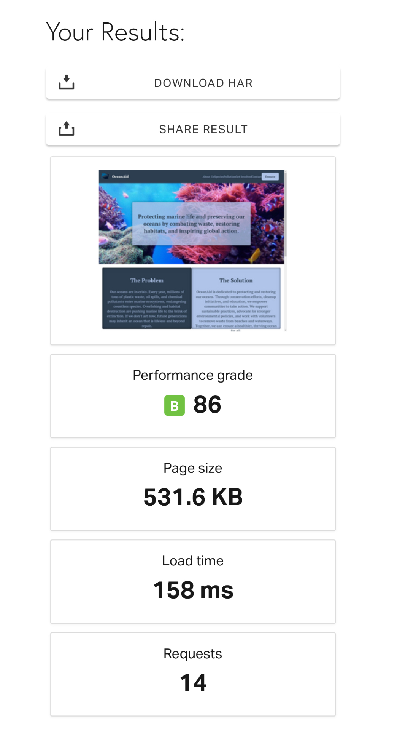
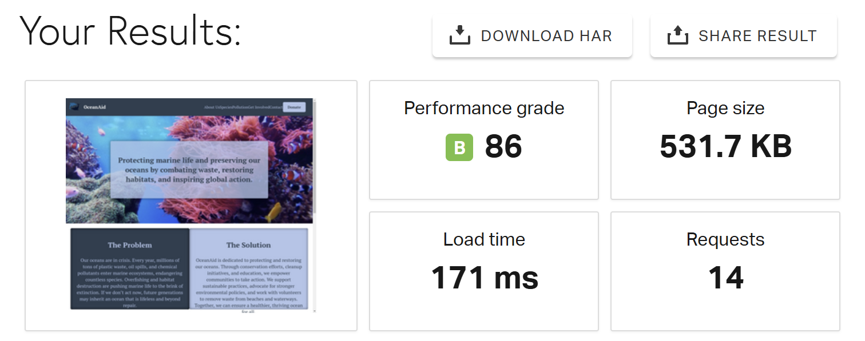
Mobile and Desktop Speed Tests
Mobile Speedtest ( used pingdom.com )
Desktop Speedtest ( used pingdom.com )

Slide 6
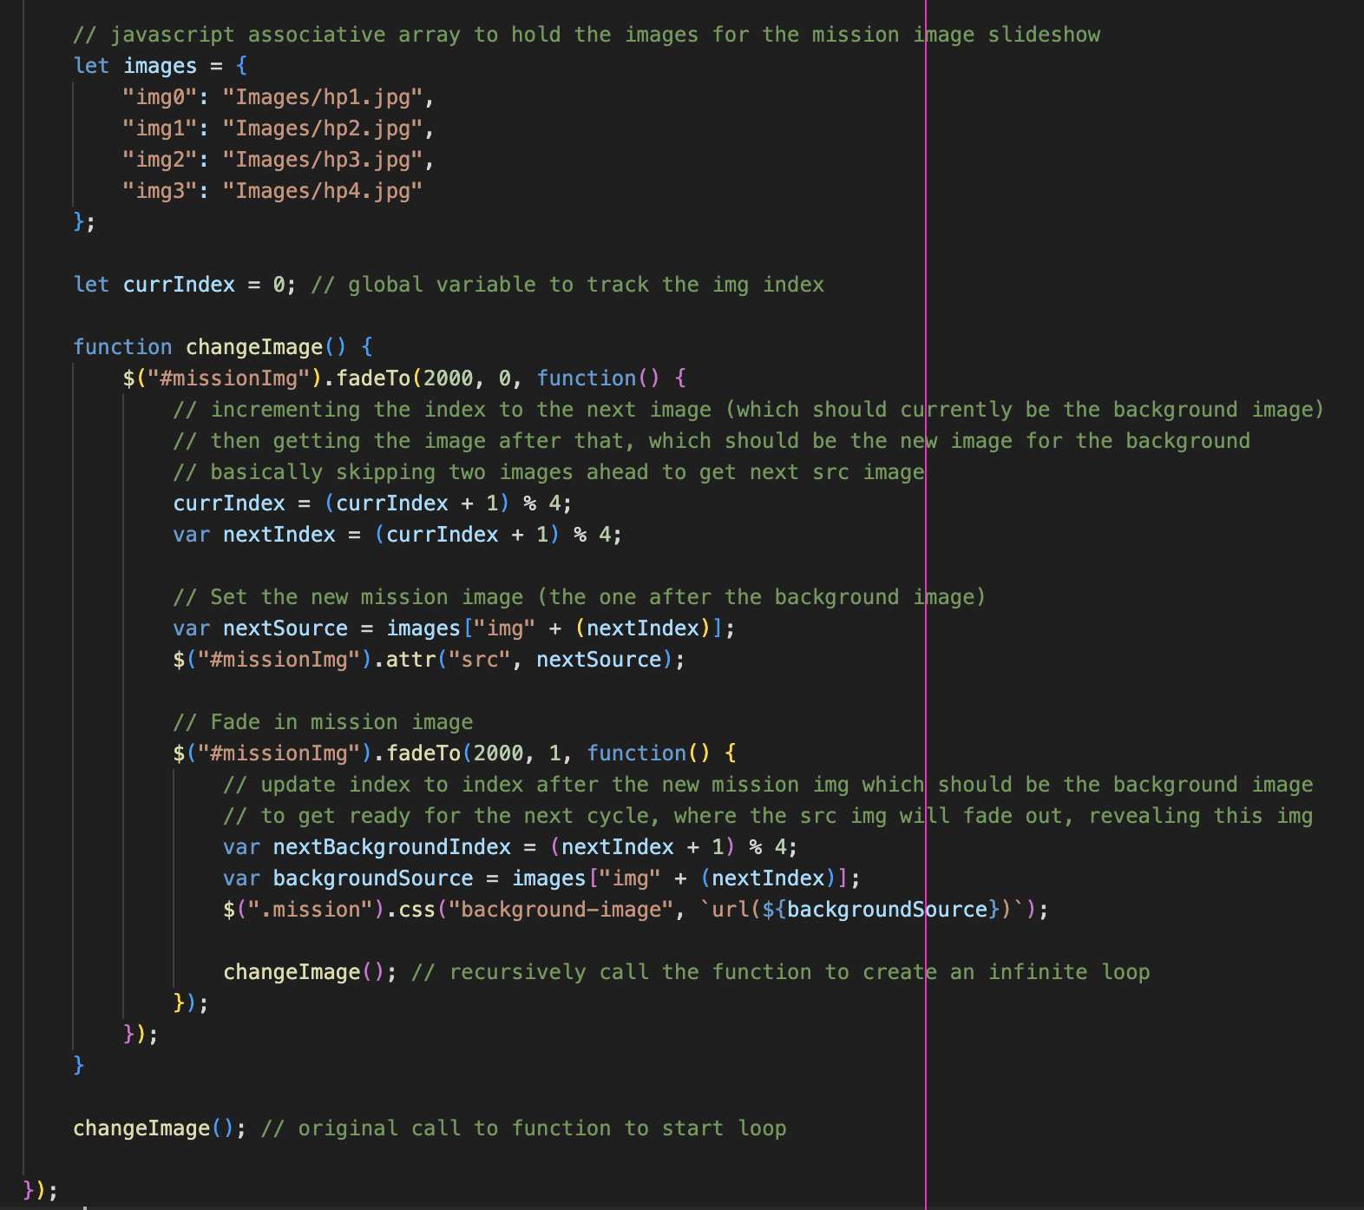
Our Favorite Section of Code
Associative array to hold images
Multiple index changes and swapping background img and src html img
Recursive design to run infinitely after first call

Slide 7
How the Team Contributed
Jan Konings
Home Page
Donate Page
Species Page
Kevin Lu
About Us Page
Get Involved Page
Header/Footer
Ryan Chen
Pollution Page
Contact Page
Presentation
As a team we worked to help each other with certain design choices for each page and also the different issues that we encountered throughout the project.

Slide 8
Links to All Pages
Home Page: https://jankonings.github.io/CS20-Midterm/index.html
About Us Page: https://jankonings.github.io/CS20-Midterm/aboutUs.html
Species Page: https://jankonings.github.io/CS20-Midterm/species.html
Pollution Page: https://jankonings.github.io/CS20-Midterm/pollution.html
Get Involved Page: https://jankonings.github.io/CS20-Midterm/getInvolved.html
Donate Page: https://jankonings.github.io/CS20-Midterm/donate.html

